Slide 1

Software engineering (Undergraduate)
Chapter 1
Lab task 1
Course Name
software engineering
CSC 3114
(Undergraduate)
Jubayer ahamed
Lecturer, CS, AIUB
jubayer@aiub.edu
https://scholar.google.com/citations?view_op=list_works&hl=en&hl=en&user=WXtW1XMAAAAJ

Slide 2
what is Software engineering?
Slide - 2
Technologies that make it easier, faster, and less expensive to build high-quality computer programs
A discipline aiming at producing fault-free software, delivered on time and within budget, that satisfies the users’ needs.
An engineering: A set of activities in software production
The philosophy of established engineering disciplines to solve what are termed software crisis
SB

Slide 3
Scope of software Engineering
Slide - 3
The aim of Software Engineering is to solve Software Crisis:
  Late
  Over budget
  Low quality with lots of faults
Software crisis is still present over 35 years later!
SB

Slide 4
Software characteristics
Slide - 4
A logical (intangible) rather than a physical system element
Being developed or engineered but not being manufactured
Software cost concentrating in engineering, not in materials
Software does not “wearing out” but “deteriorating”(not destroyed after lifetime like hardware, but backdated by aging that needs to update)
Software is a ‘differentiator’ (different sub-systems, e.g. cashier’s workstation in a supermarket)
Without “spare parts” in software maintenance (no extra useless features in software)
Most software continues to be custom-built (based on the requirements)
SB

Slide 5
Software development life cycle (SDLC)
Slide - 5
A structured set of activities required to develop a software system
The way we produce software, including:
Planning
Requirements Analysis
Design
Development
Testing
Final release / Deployment
Maintenance
SB

Slide 6
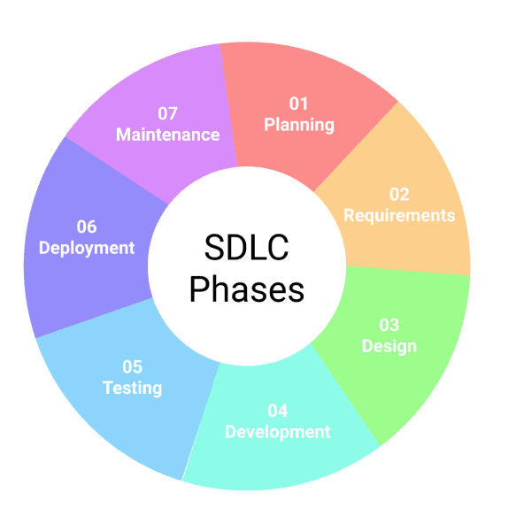
Software development life cycle (SDLC)
Slide - 6

Slide 7
Good & bad software
Slide - 7
Good software is maintained—bad software is discarded
Different types of maintenance
  Corrective maintenance [about 20%]
    Modification to fix a problem
  Enhancement [about 80%]
    Perfective maintenance (modification to improve usability,…) [about 60%]
    Adaptive maintenance (modification to keep up-to-date) [about 20%]
    Preventive maintenance (modification to avoid any future error) [about 20%]
SB

